Slide 1
XSS Attack
Anushika Chauhan
Center for Advance Studies
M.Tech - Cyber Security

Slide 2
What is XSS?
Cross-site Scripting (XSS) refers to client-side code injection attack wherein an attacker can execute malicious scripts (also commonly referred to as a malicious payload) into a legitimate website or web application.
XSS occurs when a web application makes use of unvalidated or unencoded user input within the output it generates.

Slide 3
ExPLOIT Vulnerabilities of -
It takes advantage of vulnerabilities of ActiveX, Flash, VBScript, and the most widely abused is JavaScript.

Slide 4
What’s the worst an attacker can do with JavaScript?
Access to cookies – can be used for impersonating that user.
Can read and make arbitrary modifications to the browser’s DOM .
can use XMLHttpRequest to send HTTP requests to arbitrary destinations.
JavaScript in modern browsers can leverage HTML5 APIs such as accessing a user’s geolocation, webcam, microphone and even the specific files from the user’s file system.

Slide 5
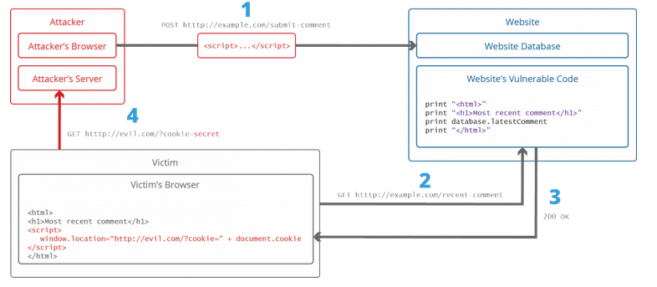
The anatomy of a Cross-site Scripting attack

Slide 6
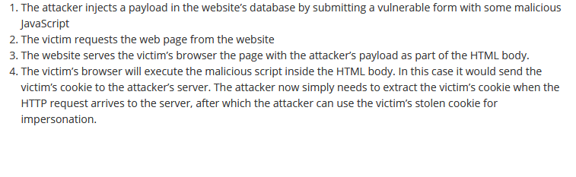
Notes:
Cookies can store a wide range of information, including personally identifiable information (such as your name, home address, email address, or telephone number).

Slide 7
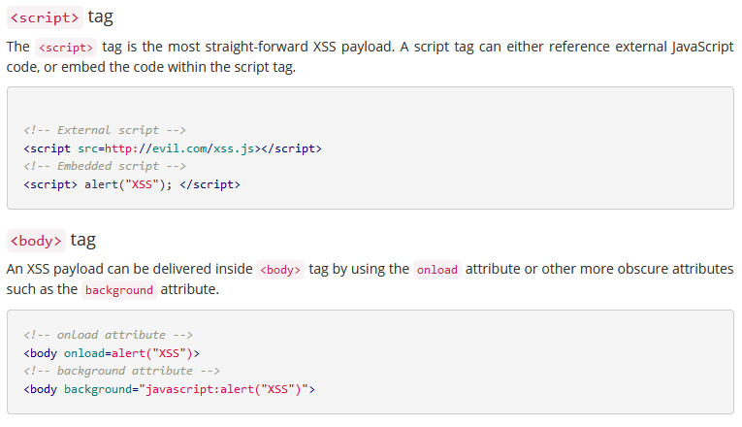
Some examples of Cross-site Scripting attack vectors

Slide 8
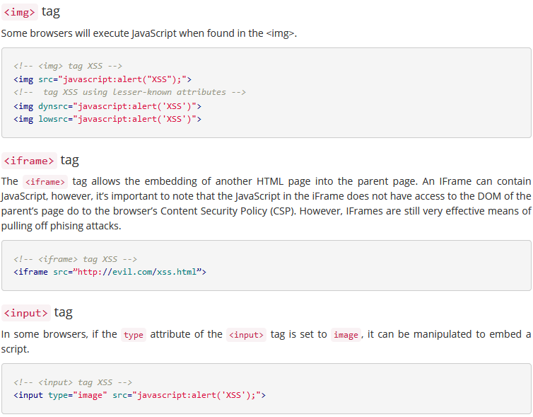

Slide 9
Types of Xss
Reflected XSS – The first Order XSS
A Reflected XSS occurs when untrusted user data is submitted to a web application that is then immediately echoed back into the response, effectively reflecting the untrusted content in the page. The browser sees the code come from the web server, assumes it’s safe, and executes it.
Here, the attacker’s payload script has to be part of the request which is sent to the web server and reflected back in such a way that the HTTP response includes the payload from the HTTP request.

Slide 10
TYPES …
Stored XSS – The Second Order XSS
This version arises when data submitted by one user is stored in the application (typically in a back-end database) and then is displayed to other users without being filtered or sanitized appropriately.
Stored (or Persistent) XSS flaws are similar to Reflected XSS except that the XSS is persisted in data storage within the web application.

Slide 11
Stored XSS…
Attacks against stored XSS vulnerabilities typically involve at least two requests to the application. In the first, the attacker posts some crafted data containing malicious code that the application stores. In the second, a victim views a page containing the attacker’s data, and the malicious code is executed when the script is executed in the victim’s browser. For this reason, the vulnerability is also sometimes called second-order cross-site scripting.

Slide 12
Types…
DOM-Based XSS
Document Object Model (DOM) XSS is a purely client-side form of XSS. This differs from both Reflected and Stored XSS in that the vulnerability exists only within client-side code, such as JavaScript.
It is made possible when the web application’s client side scripts write user provided data to the Document Object Model (DOM). The data is subsequently read
from the DOM by the web application and outputted to the browser. If the data is incorrectly handled, an attacker can inject a payload, which will be stored as part of the DOM and executed when the data is read back from the DOM.

Slide 13
DOM-Based…
The most dangerous part of this attack is often a client-side attack, and the attacker’s payload is never sent to the server. This makes it even more difficult to detect for Web Application Firewalls (WAFs) and security engineers analyzing the server’s logs since they will never even see the attack.

Slide 14
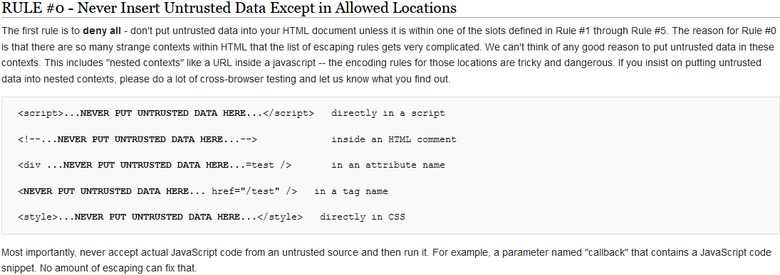
XSS Prevention Rules

Slide 15
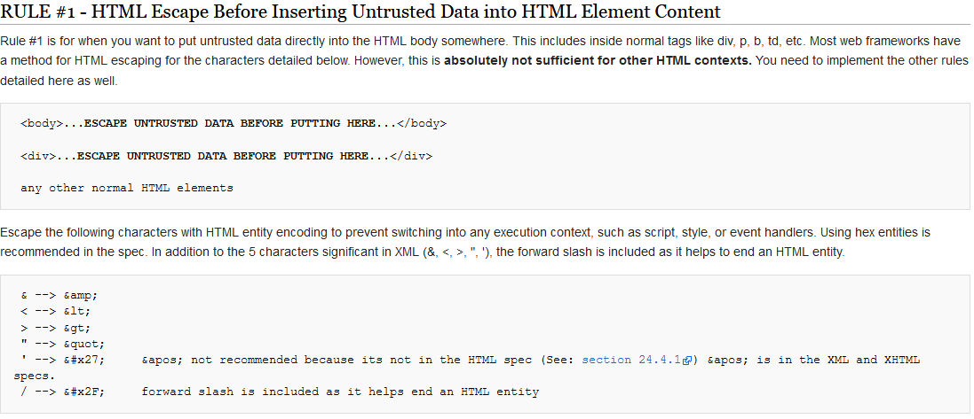
Notes:
" is replaced with &quot; & is replaced with &amp; < is replaced with &lt; > is replaced with &gt;

Slide 16
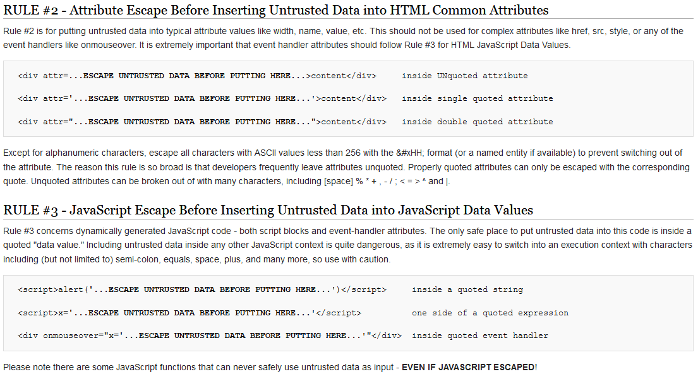
Notes:
https://web.liferay.com/community/wiki/-/wiki/Main/Escaping

Slide 17
Case Studies
1. Apache Foundation Compromised with Reflected XSS – 2010
2. In 2005, the social networking site MySpace was found to be vulnerable to a stored XSS attack.
3. In 2009, StrongWebmail – stored XSS
4. In 2009, Twitter – stored xss

Slide 18
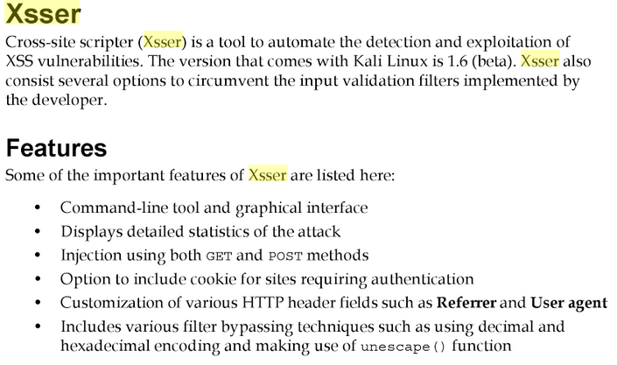
Kali tool for detecting xss vulnerabilities

Slide 19
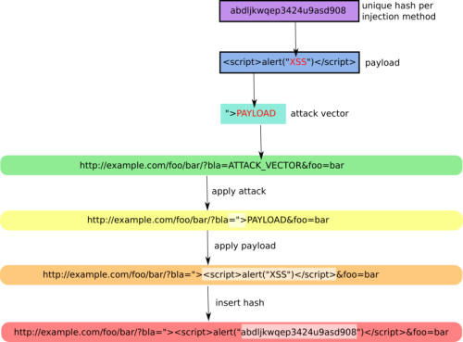

Slide 20
References
https://www.acunetix.com/websitesecurity/cross-site-scripting/
https://www.owasp.org/index.php/XSS_(Cross_Site_Scripting)_Prevention_Cheat_Sheet

